Slide 1
MSE at 2D
mean and median MSE

Slide 2
case
we random data cov matrix by:
random 2X2 matrix with all elements ~N(0,1)
do M.T*M
normalizing output to determinant 1
we know what is the best bin size per number of bins
for each number of bins, we have fixed modulo size, and we do 1M simulations with 1M random cov matrix per number of bins

Slide 3
results
we have big noise on the average MSE because the data can be with big variance on x and/or y, so the MSE will be very high if we cannot find good A matrix

Slide 4
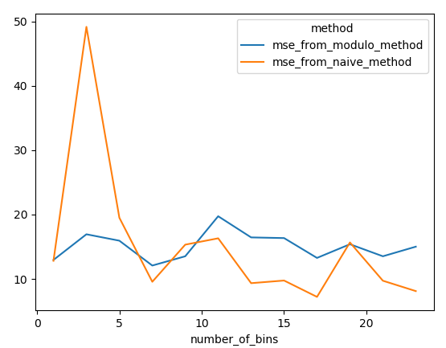
average MSE per number of bins

Slide 5
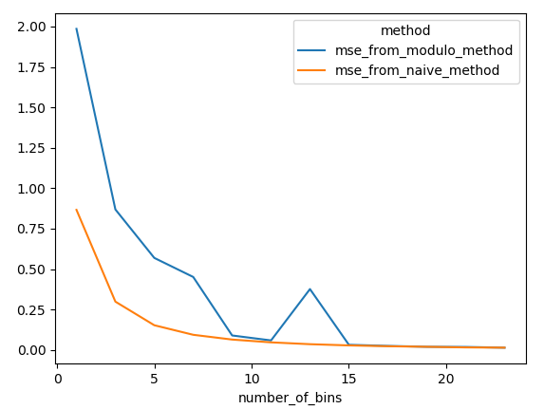
median MSE – we have less noise but we don’t know the real results

